Slide 1

AMSTer : SAR & InSAR Automated Mass processing Software for Multidimensional Time series
Nicolas d’Oreye^{1,2}, Dominique Derauw^{3,4}, Sergey Samsonov⁵,
Delphine Smittarello¹, Maxime Jaspard¹, Gilles Celli¹
ndo@ecgs.lu
amster@ecgs.lu
1 European Centre for Geodynamics and Seismology (ECGS), 19 rue Josy Welter, L-7256 Walferdange, Luxembourg
2 National Museum of Natural History (NMNH), 19 rue Josy Welter, L-7256 Walferdange, Luxembourg
3 Centre Spatial de Liège (CSL), Avenue du Pré Aily, B-4031 Angleur, Belgium
4 SAREOS, 1 Rue des Violettes, 4557 Fraiture, Belgium
5 Canada Centre for Mapping and Earth Observation, Natural Resources Canada (NRCAN), 560 Rochester Street, Ottawa, ON K1A 0E4, Canada

Slide 2
AMSTer Toolbox
- Optional module for MasTer Toolbox -
Optimised pair selection
D. Smittarello¹
¹ European Center for Geodynamics and Seismology, Luxembourg (delphine@ecgs.lu)

Slide 3
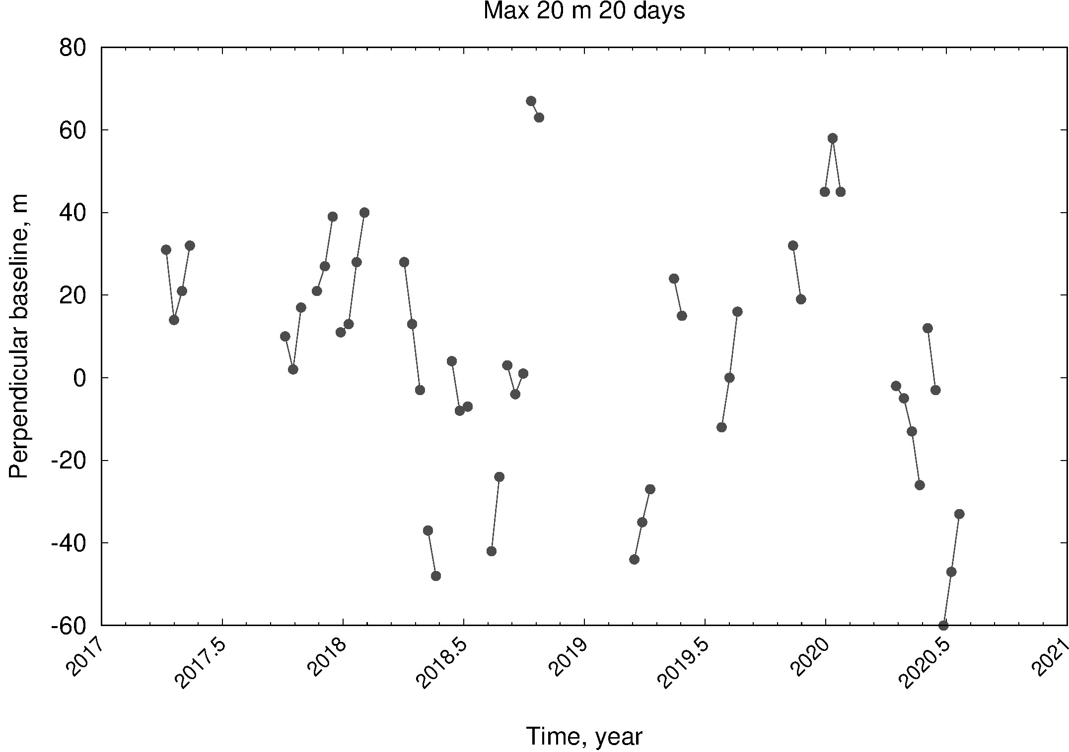
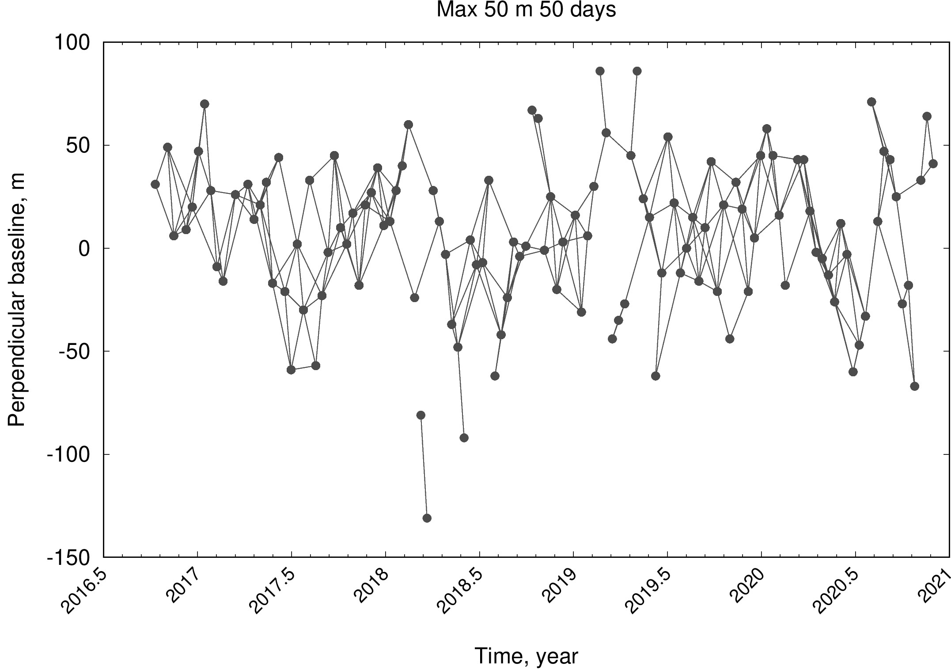
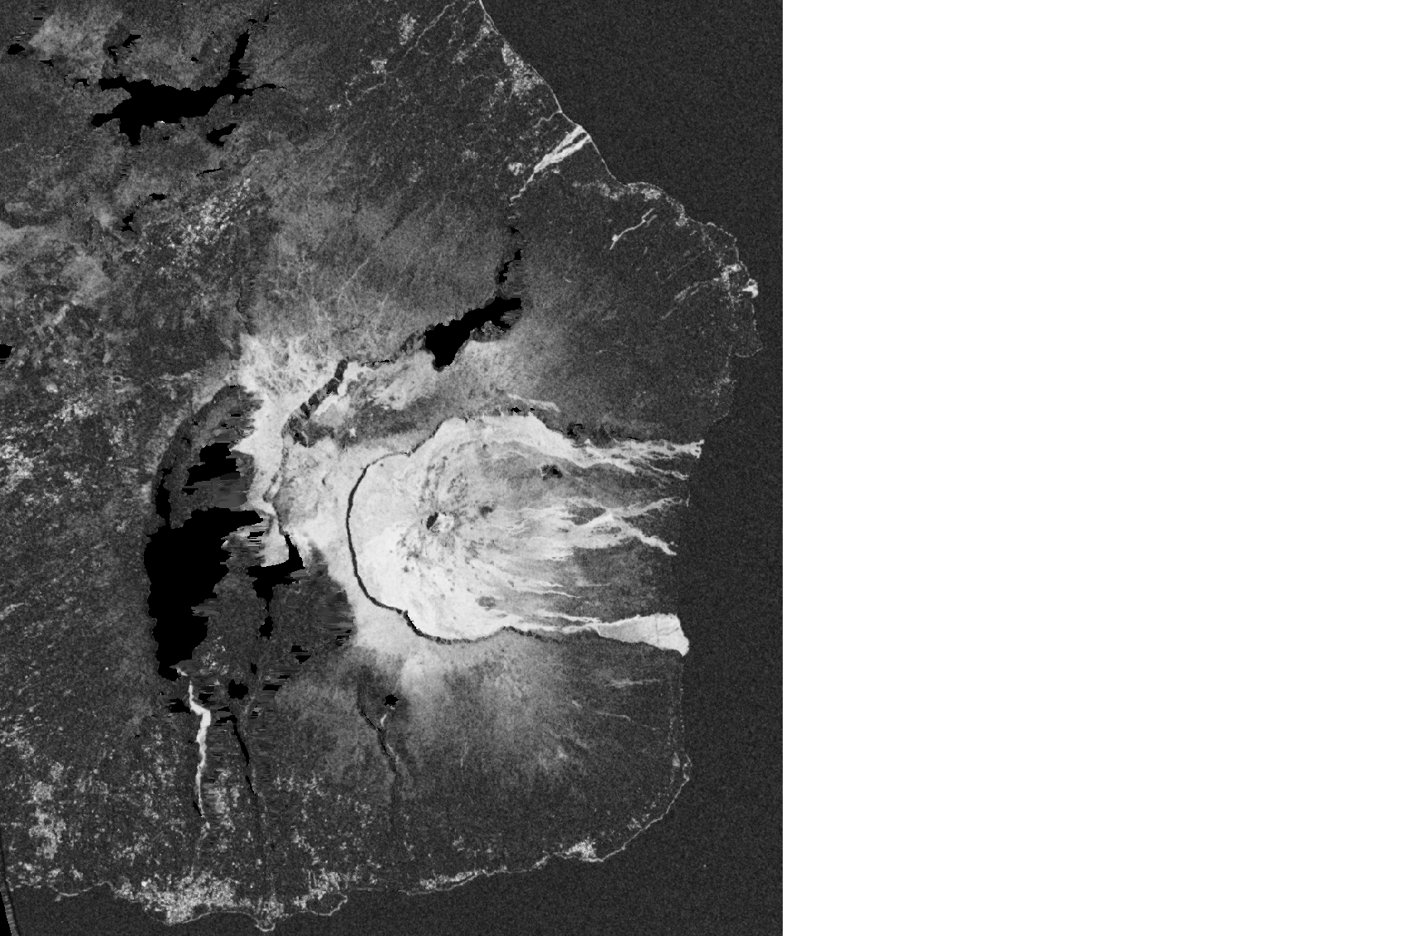
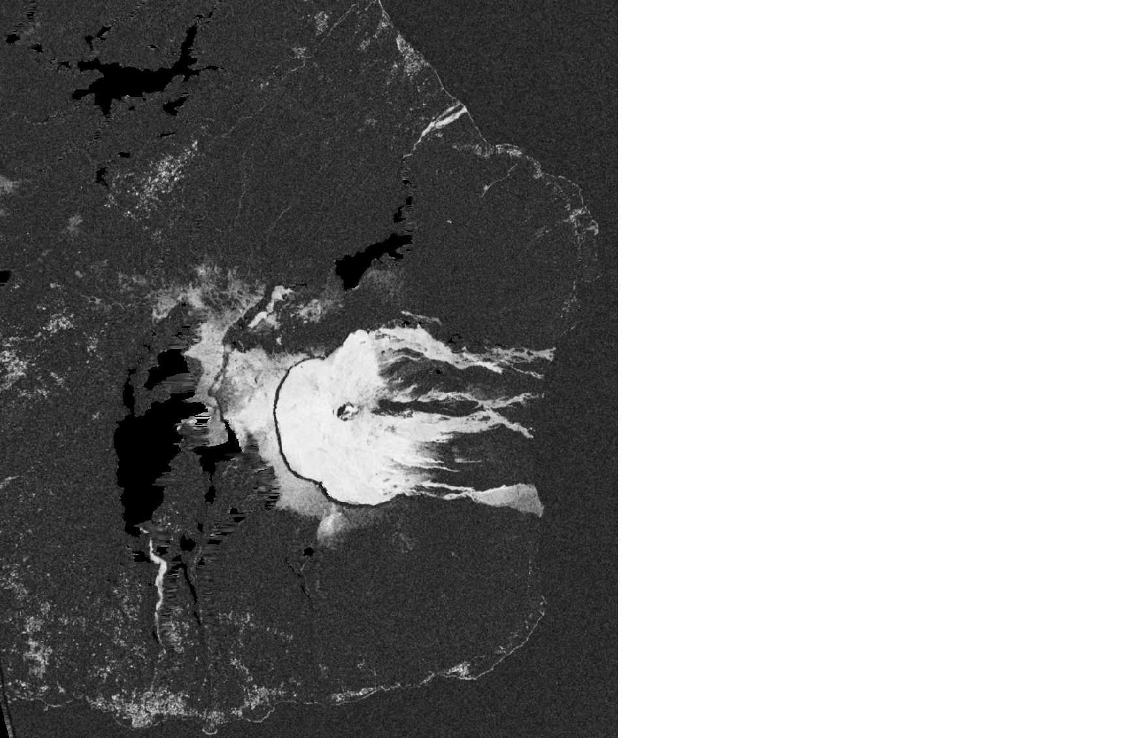
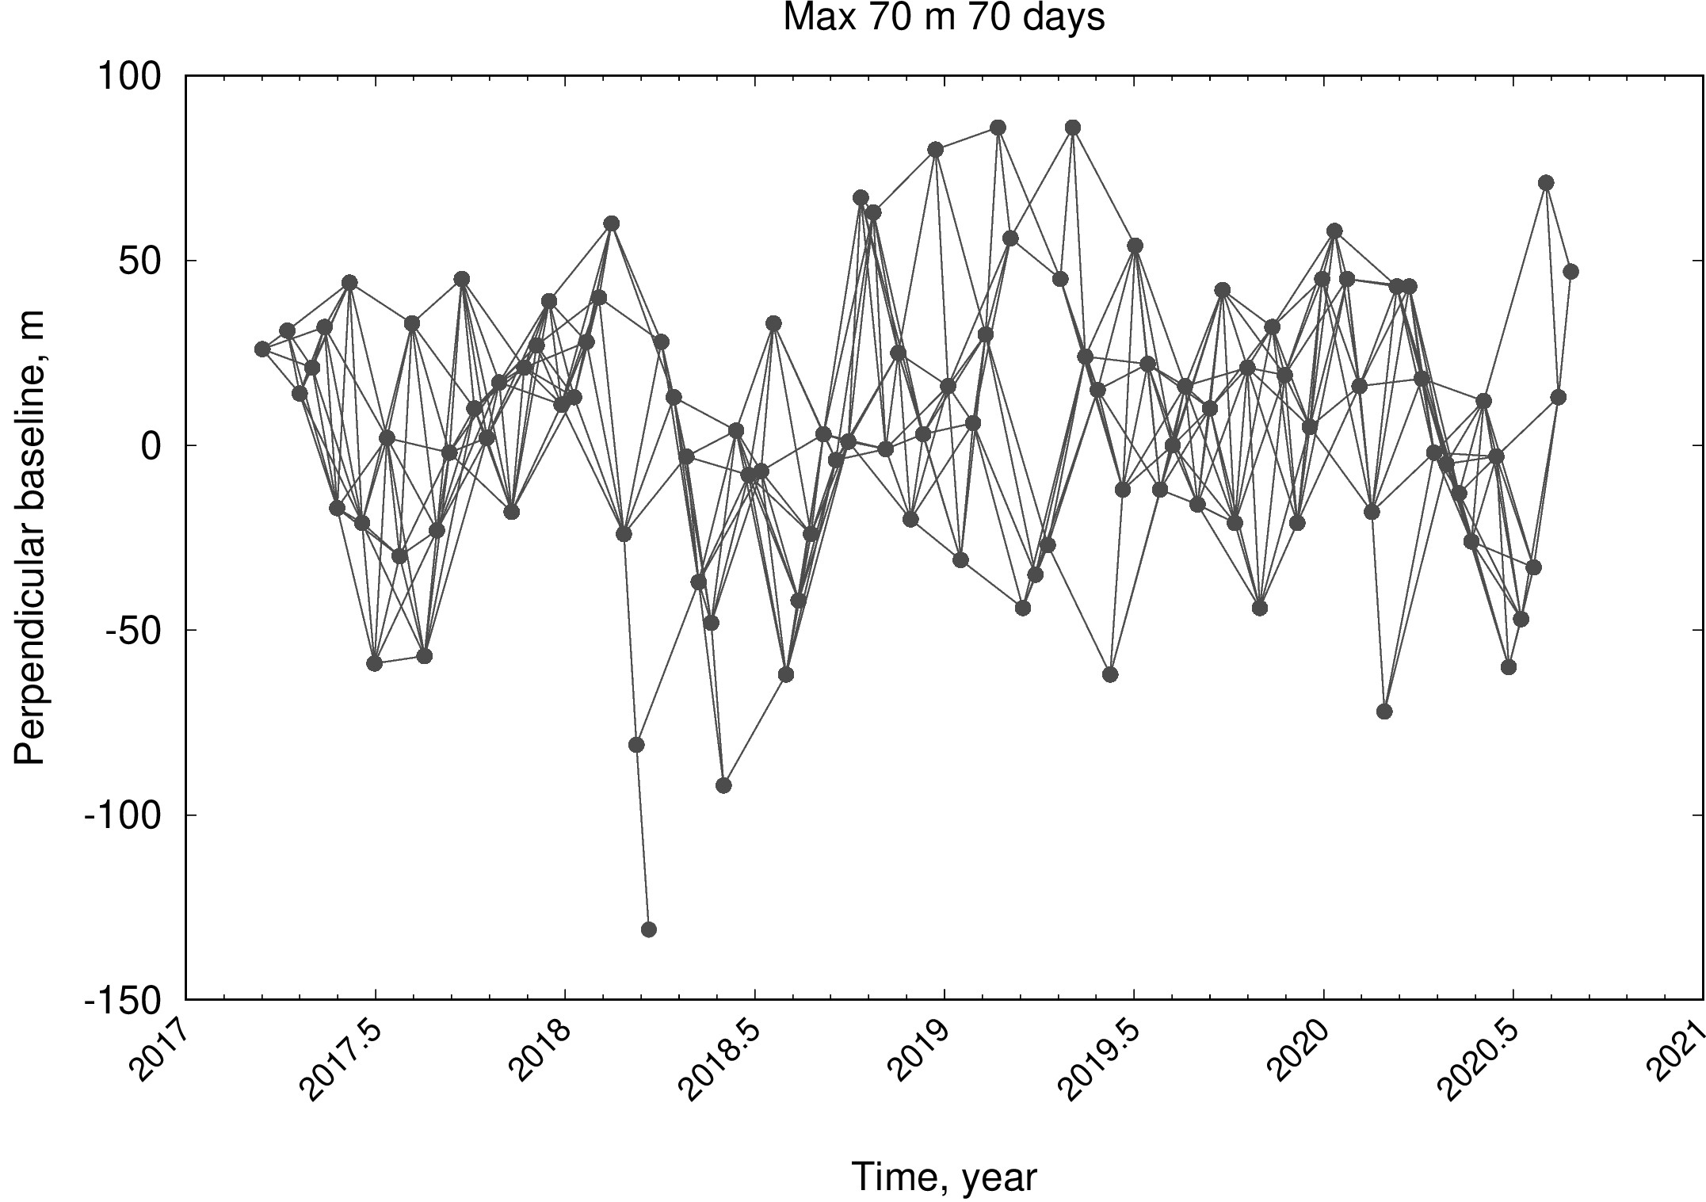
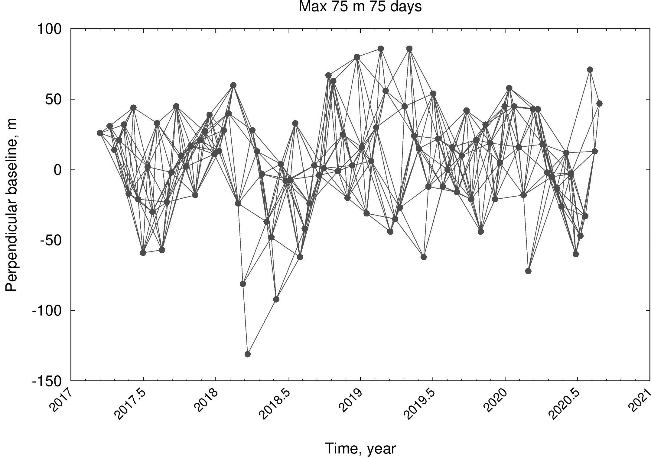
Pair Selection Principle in AMSTer Toolbox
User need to chose BT_{max} and BP_{max}
Short baselines = better coherence Long baselines = better connectivity
BT_{max} = 20 days ; BP_{max} = 20m
BT_{max} = 50 days ; BP_{max} = 50m
BT_{max} = 70 days ; BP_{max} = 70m
BT_{max} = 75 days ; BP_{max} = 75m
BT = 12 days
BT = 72 days

Slide 4
Pair Selection Principle in AMSTer Toolbox
User need to chose BT_{max} and BP_{max}
Best compromise depends on :
Area characteristics
Satellite orbits characteristics
Expected displacement velocity
And also :
Computational resources
Storage resources

Slide 5


Why do we need optimization ?
While working with :
Larger and larger databases
Limited computer resources
Optimization aims at :
Saving computation time
Saving storage resources
Improve ? / Not degrade results

Slide 6
Optimization Principle
List of SAR acquisitions (AMSTer inputs) => Prepa_msbas.sh
List of interferograms to compute => SAR_MASS_Processing
List of deformation maps to invert => MSBAS
Time series (AMSTer final products)

Slide 7
Optimization Principle
List of SAR acquisitions (AMSTer inputs) => Prepa_msbas.sh
List of interferograms to compute => SAR_MASS_Processing
List of deformation maps to invert => MSBAS
Time series (AMSTer final products)
Option 1
Option 2
Remove from the list

Slide 8
Optimization Principle
List of SAR acquisitions (AMSTer inputs) => Prepa_msbas.sh
List of interferograms to compute => SAR_MASS_Processing
List of deformation maps to invert => MSBAS
Time series (AMSTer final products)
Option 1
Option 2
Remove from the list
Additional constraints :
Keep sufficient graph connectivity
Remove poor quality interferograms
Use each image as often as primary and as secondary image

Slide 9
A Graph Framework
4 Nodes
5 Edges
Interf 1-3 = out of BT - BP criteria
Baseline Plot = Graph
SAR acquisitions = nodes
Interferograms = edges
SAR 2
Interf 1-2
Interf 2-4
SAR 1
Interf 1-4
Interf 2-3
SAR 4
Interf 3-4
SAR 3

Slide 10
A Graph Framework
4 Nodes
5 Edges
Interf 1-3 = out of BT - BP criteria
Baseline Plot = Graph
SAR acquisitions = nodes
Interferograms = edges
Node Degree = number of connected neighbors
example : SAR 2 : degree 3
SAR 3 : degree 2
SAR 2
Interf 1-2
Interf 2-4
SAR 1
Interf 1-4
Interf 2-3
SAR 4
Interf 3-4
SAR 3

Slide 11
A Graph Framework
4 Nodes
5 Edges
Interf 1-3 = out of BT - BP criteria
Baseline Plot = Graph
SAR acquisitions = nodes
Interferograms = edges
Graph is oriented : Node In-degree = number of incoming connections
Node Out-degree = number of outcoming connections
example : SAR 2 : In-degree 1 – Out-degree 2
SAR 3 : In-degree 1 – Out-degree 1
SAR 2
Interf 1-2
Interf 2-4
SAR 1
Interf 1-4
Interf 2-3
SAR 4
Interf 3-4
SAR 3

Slide 12
A Graph Framework
4 Nodes
5 Edges
Interf 1-3 = out of BT - BP criteria
Baseline Plot = Graph
SAR acquisitions = nodes
Interferograms = edges
Optimization
Same In-degree and Out-degree for all node : k
Find a subgraph by removing non-necessary edges
SAR 2
Interf 1-2
Interf 2-4
SAR 1
Interf 1-4
Interf 2-3
SAR 4
Interf 3-4
SAR 3

Slide 13
A Graph Framework
I chose k=3

Slide 14
A Graph Framework
I chose k=3
Which edges do I remove ?
SAR i

Slide 15
A Graph Framework
I chose k=3
Which edges do I remove ?
SAR i
In-degree = 3
3=k
OK

Slide 16
A Graph Framework
I chose k=3
Which edges do I remove ?
SAR i
In-degree = 3
3=k
OK
Out-degree = 5
5>k
Remove 2 edges…

Slide 17
A Graph Framework
I chose k=3
Removable ?
ID=4>k
YES
Which edges do I remove ?
SAR i
In-degree = 3
3=k
OK
Out-degree = 5
5>k
Remove 2 edges…

Slide 18
A Graph Framework
I chose k=3
Removable ?
ID=4>k
YES
Which edges do I remove ?
SAR i
ID=3=k
No
In-degree = 3
3=k
OK
Out-degree = 5
5>k
Remove 2 edges…

Slide 19
A Graph Framework
I chose k=3
Removable ?
ID=4>k
YES
Which edges do I remove ?
SAR i
ID=3=k
No
ID=4>k
YES
ID=1<k
No
In-degree = 3
3=k
OK
Out-degree = 5
5>k
Remove 2 edges…
ID=5>k
YES
… among 3 removable

Slide 20
A Graph Framework
I chose k=3
Removable ?
ID=4>k
YES
Which edges do I remove ?
SAR i
ID=3=k
No
ID=4>k
YES
ID=1<k
No
In-degree = 3
3=k
OK
Out-degree = 5
5>k
Remove 2 edges…
ID=5>k
YES
… among 3 removable
=> Need for an additional criteria

Slide 21
Weighted Graph
Give a weight to each edge
Sort removable edges
Remove edge with the lowest weight
Coherence
Coherence Proxy
Remove in priority the poorly coherent interferograms
No need to compute the coherence of all possible pairs
Advantages
Need to compute the coherence of each pair
Need correct calibration
Inconvenient

Slide 22
Algorithm workflow
1) Create an oriented graph
2) Compute weight of each edge
3) Compute in-degree and out-degree of each node
4) For each node:
5) Compute number of edges to remove
If needed :
6) Compute number of removable edges
If possible :
7) Sort removable edges according to their weight
8) Remove edges
9) Update nodes’ degrees
end
end
End
10) Save optimized list of edges

Slide 23
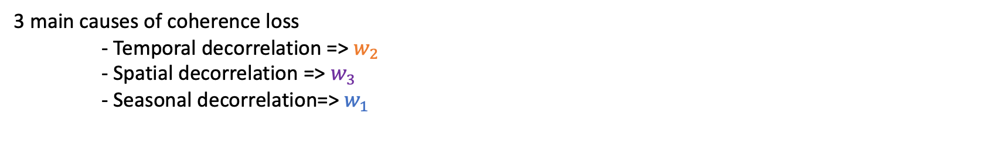

Coherence proxy
3 main causes of coherence loss
- Temporal decorrelation => $w_{2}$
- Spatial decorrelation => $w_{3}$
- Seasonal decorrelation=> $w_{1}$
$$w=a w_{1}+b w_{2}+ c w_{3}$$
a, b and c are inverted using a calibration subset of coherence values for a list of pairs.

Slide 24
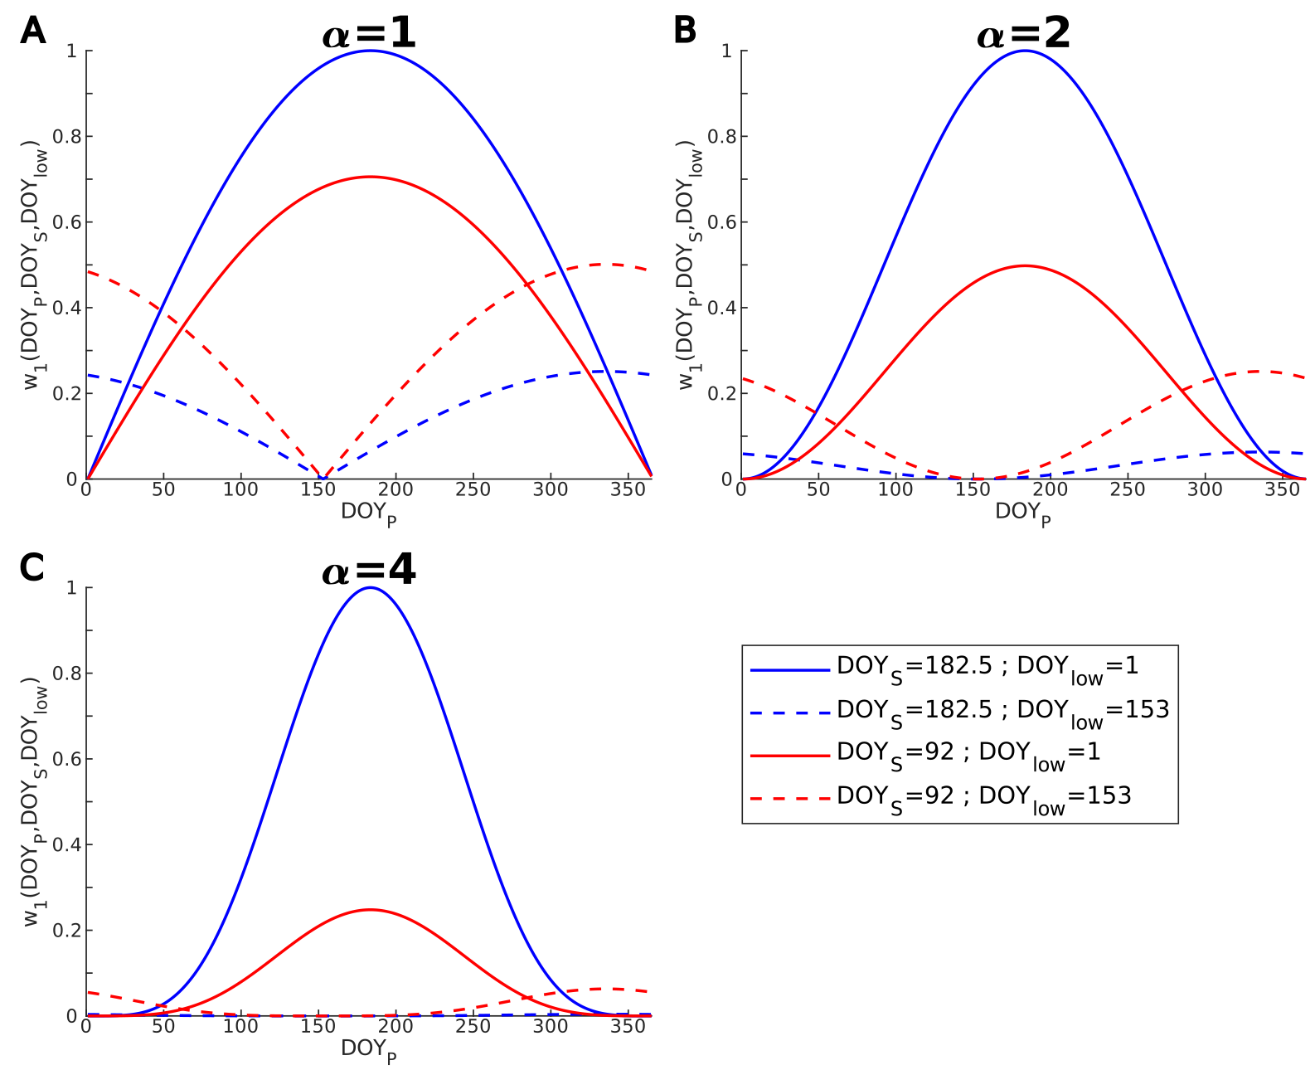
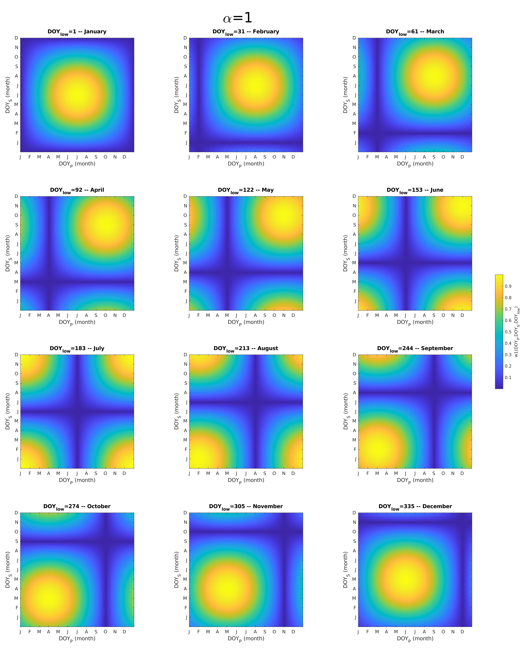
Coherence proxy
Seasonal contribution $w_{1}$
$$w_{1}={\left|\sin\left(\frac{{DOY}_{P}+\left(365−{DOY}_{low}\right)}{365}×π\right)×\sin\left(\frac{{DOY}_{S}+\left(365−{DOY}_{low}\right)}{365}×π\right)\right|}^{α}$$

Slide 25
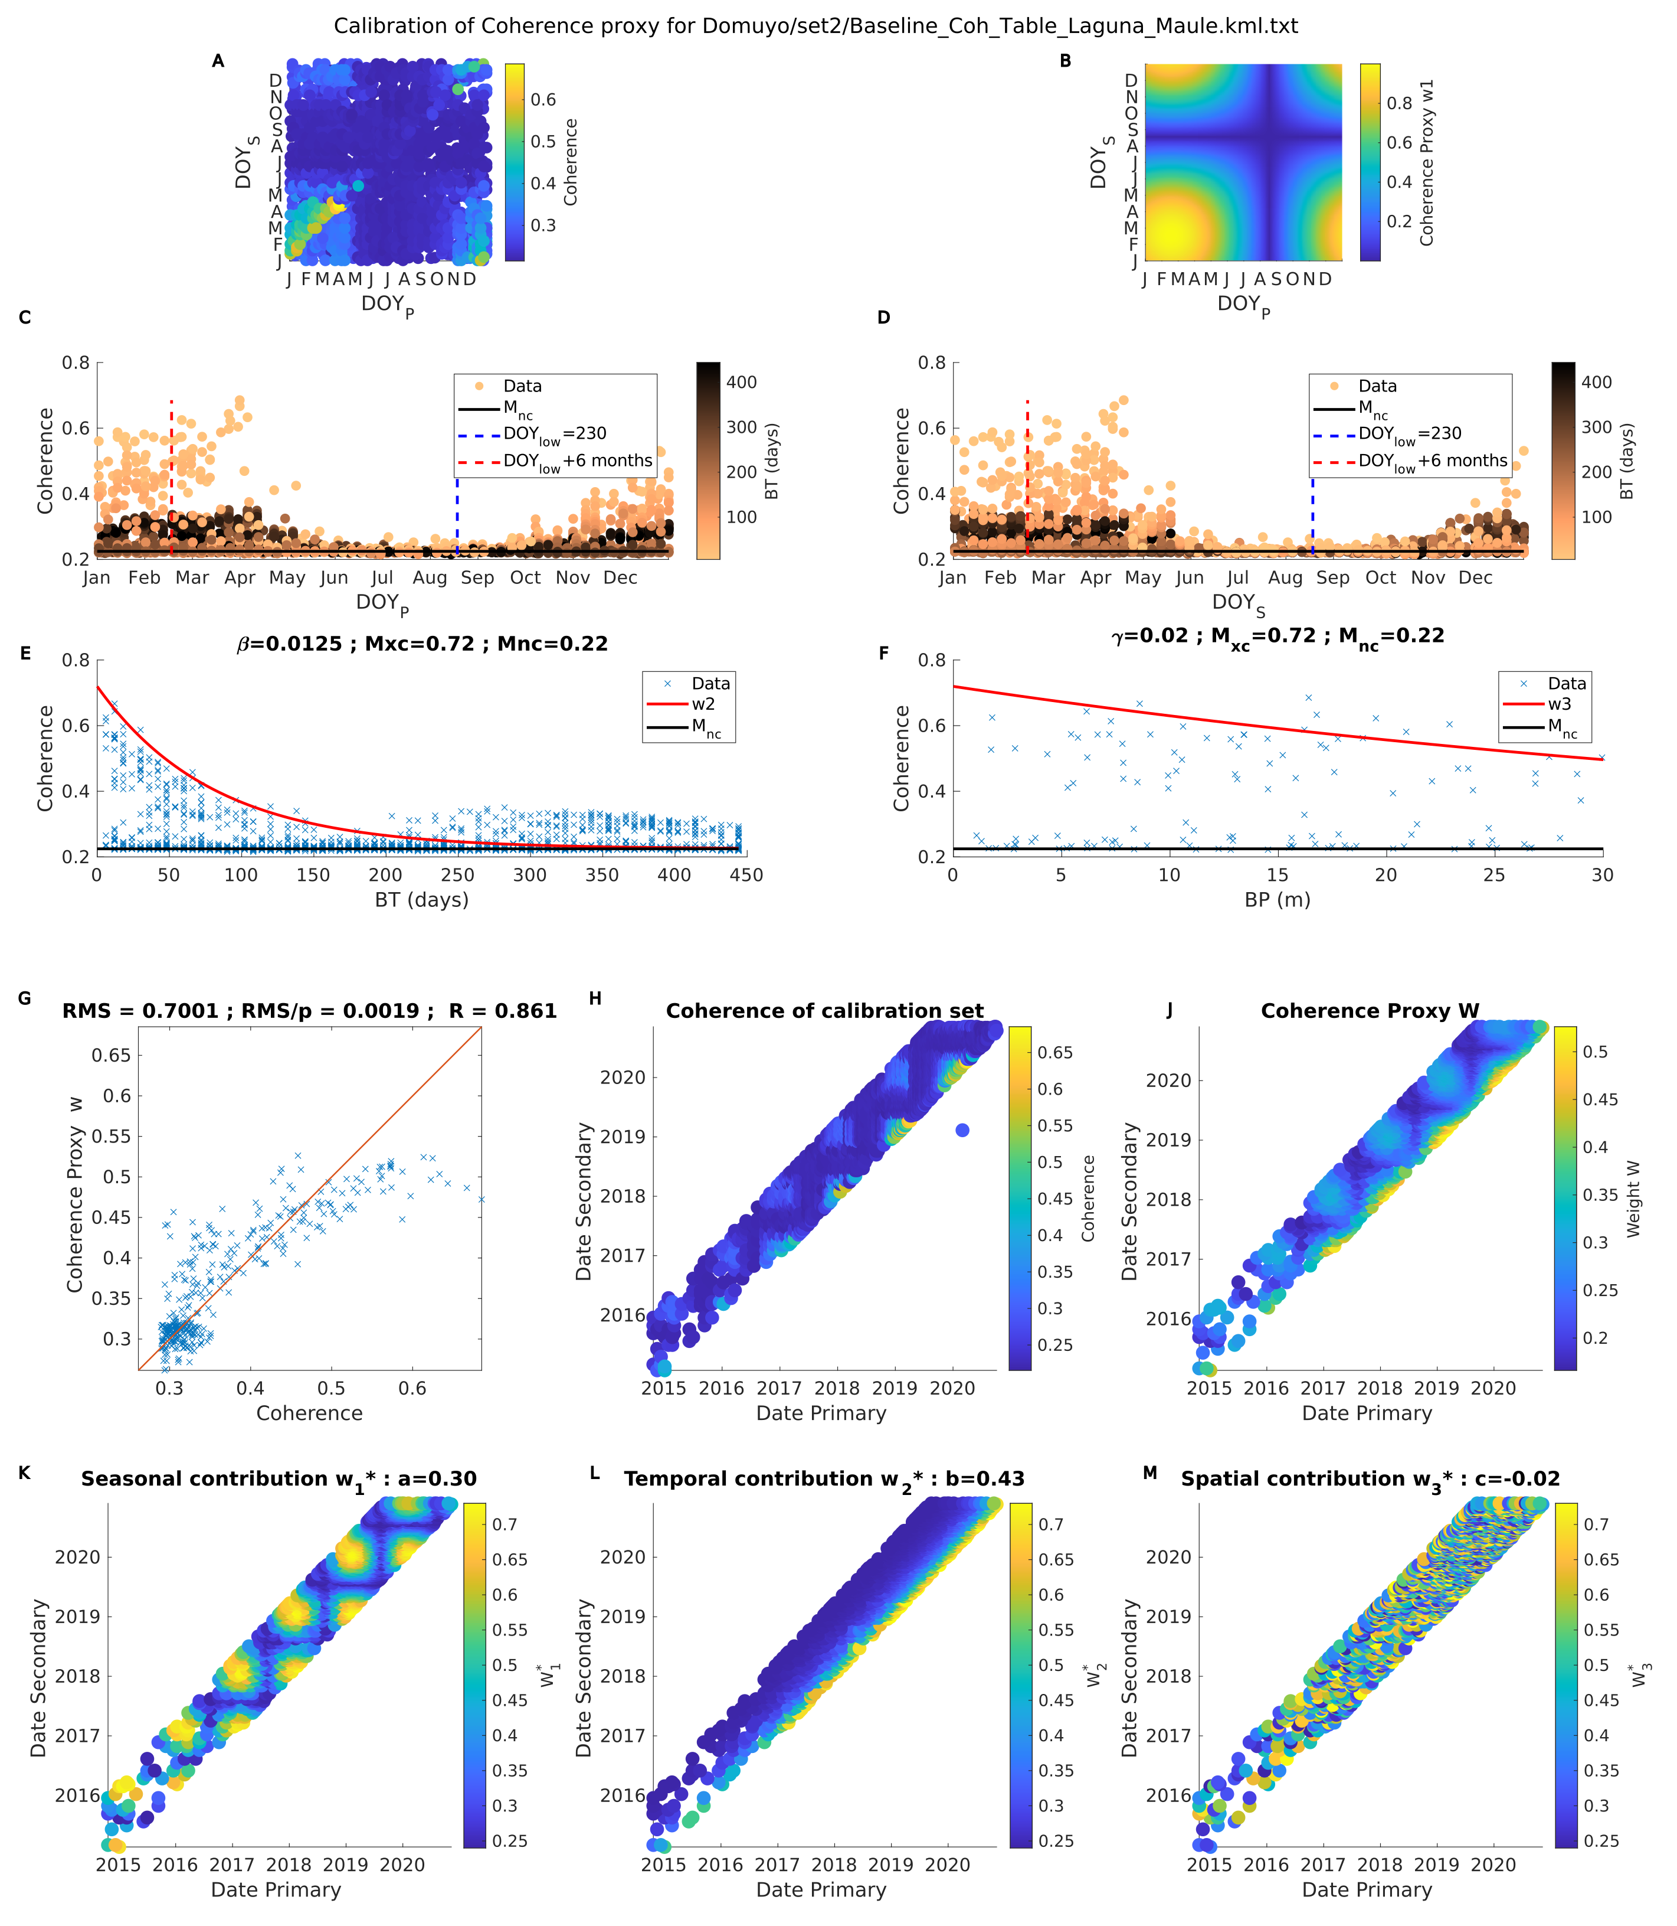
Coherence proxy
Temporal contribution $w_{1}$
$$w_{1}={\left|\sin\left(\frac{{DOY}_{P}+\left(365−{DOY}_{low}\right)}{365}×π\right)×\sin\left(\frac{{DOY}_{S}+\left(365−{DOY}_{low}\right)}{365}×π\right)\right|}^{α}$$

Slide 26
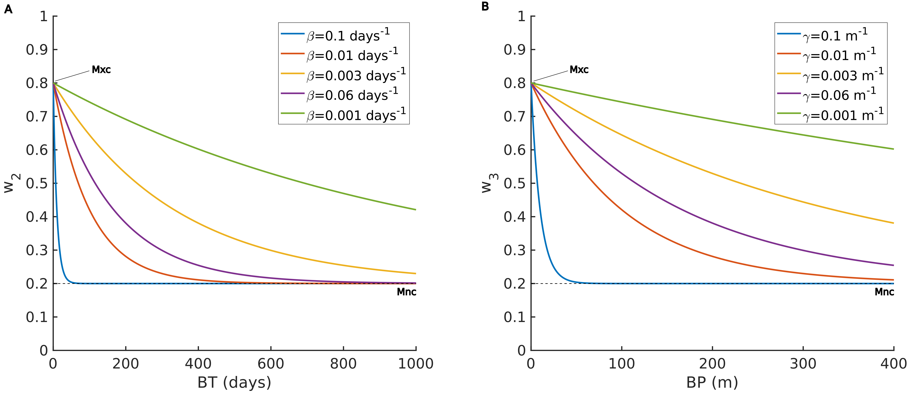


Coherence proxy
Temporal contribution $w_{2}$
Spatial contribution $w_{3}$
$$w_{2}=\left(M_{xc}−M_{nc}\right)e^{−β\left|B_{T}\right|}+M_{nc}$$
$$w_{3}=\left(M_{xc}−M_{nc}\right)e^{−γ\left|B_{P}\right|}+M_{nc}$$

Slide 27
Coherence proxy
Temporal contribution $w_{2}$
$$w_{2}=\left(M_{xc}−M_{nc}\right)e^{−β\left|B_{T}\right|}+M_{nc}$$

Slide 28

Coherence proxy
Spatial contribution $w_{3}$
$$w_{3}=\left(M_{xc}−M_{nc}\right)e^{−γ\left|B_{P}\right|}+M_{nc}$$

Slide 29

Coherence proxy
Coherence Vs Coherence Proxy $w$
$$w=a w_{1}+b w_{2}+ c w_{3}$$
a, b and c are inverted using a calibration subset of coherence values for a list of pairs.

Slide 30
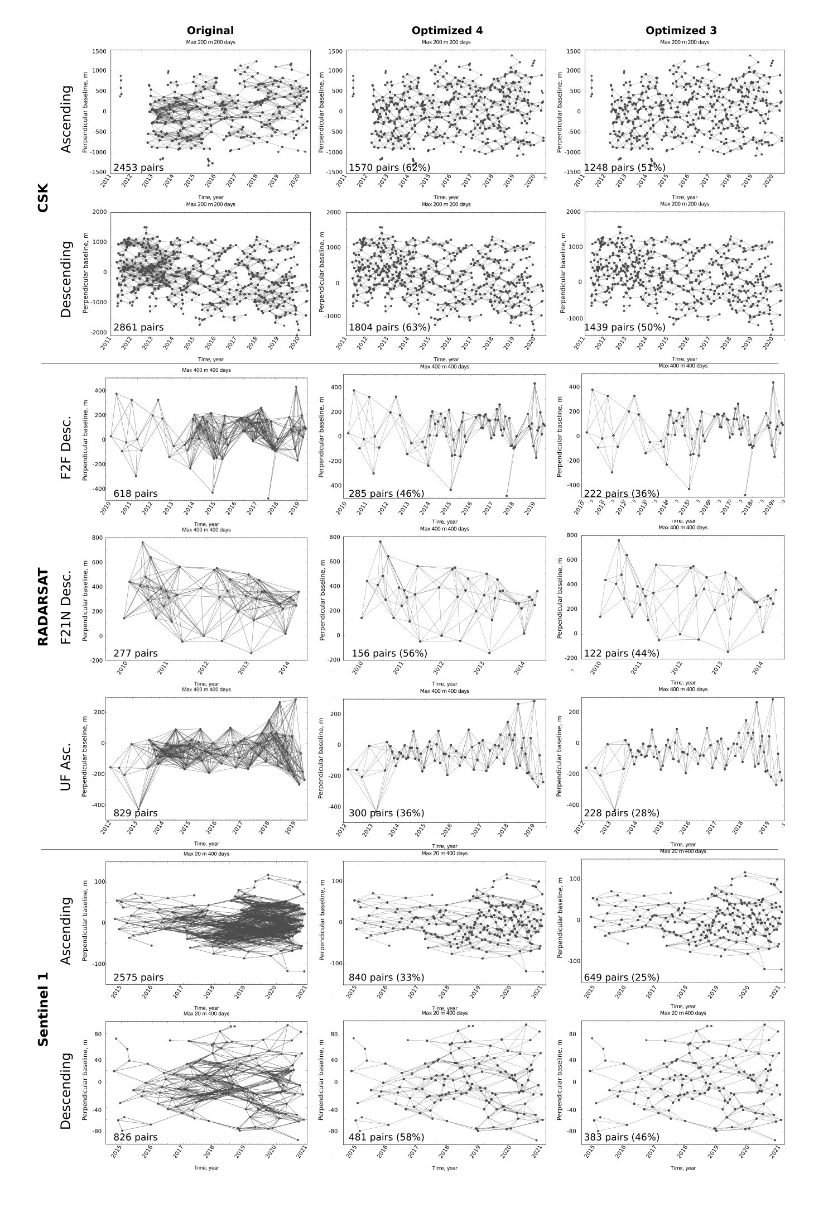
Some results

Slide 31
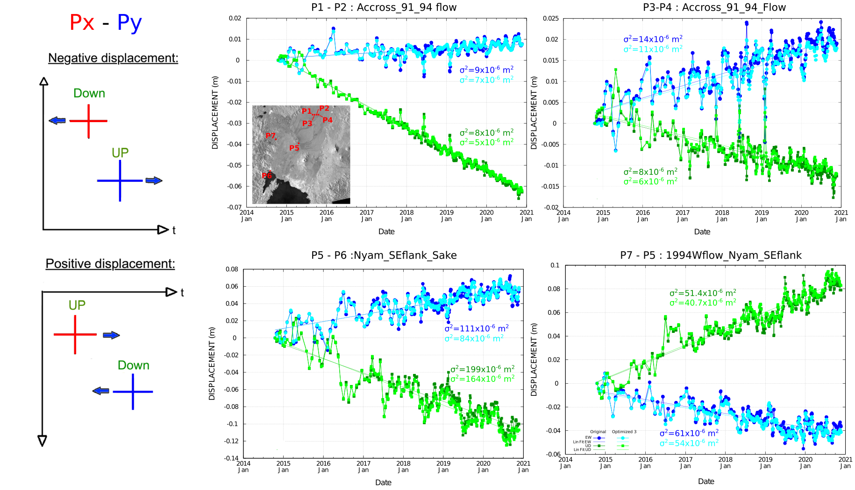
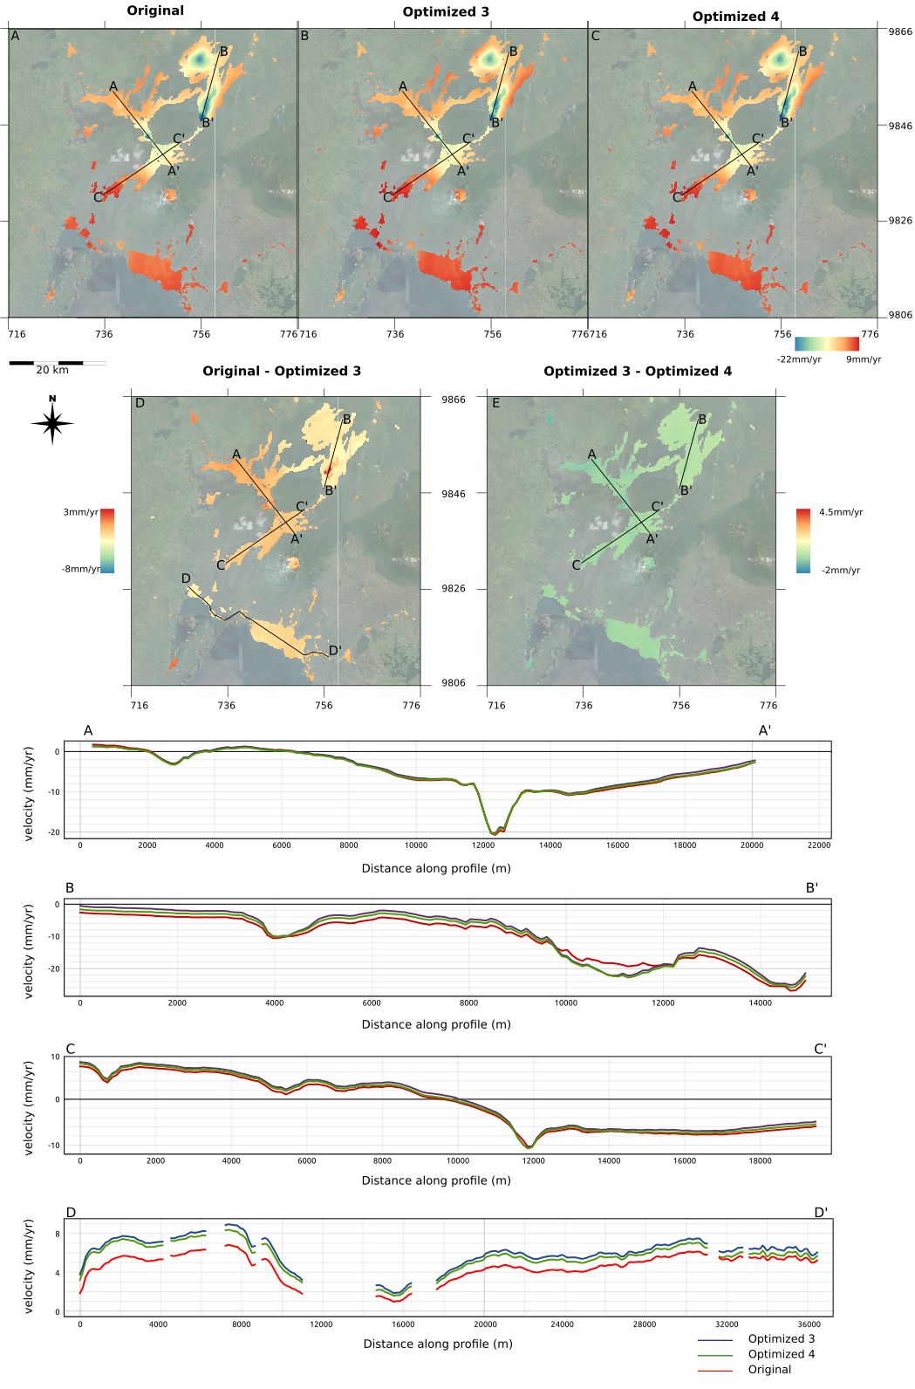
Some results

Slide 32
Some results

Slide 33
The optimization toolbox practically
Exercise part 1: Install
Copy optimtoolbox.zip in $HOME/SAR/AMSTer
Open a terminal :
cd $HOME/SAR/AMSTer
unzip optimtoolbox.zip
chmod u+x $HOME/SAR/AMSTer/optimtoolbox/*.py
chmod u+x $HOME/SAR/AMSTer/optimtoolbox/*.sh
cd
edit .bashrc
Add line :
PATH=$PATH:$HOME/SAR/AMSTer/optimtoolbox
Save and quit text editor
In terminal :
source .bashrc
Already done if installation performed with AMSTer_install.sh

Slide 34
The optimization toolbox practically
Exercise part 2: How to use
- Prepare a kml defining your calibration ROI in $PATH_1650/kml/ARGENTINA/Domuyo_Edifice.kml
- Prepare Coherence table calibration
cd $PATH_3601/SAR_MASSPROCESS/S1/ARG_DOMU_LAGUNA_A_18_SAMPLE/…
…SMNoCrop_SM_20180512_Zoom1_ML4/Geocoded/Coh
Baseline_Coh_Table.sh $PATH_1650/kml/ARGENTINA/Domuyo_Edifice.kml
Output is a text file in …/Geocoded/Coh/Baseline_Coh_Table_Domuyo_Edifice.kml.txt

Slide 35
The optimization toolbox practically
Exercise part 2: How to use
Optimize Pair table
cd $PATH_1650/SAR_SM/MSBAS/ARGENTINE/set1
Check if table.orig already exists
Option 1 : Run using coherence values (4 arguments – same pairs in both tables)
Run_optim_module.sh $PATH_1650/SAR_SM/MSBAS/…/seti/table_0_BP_0_BT.txt
$PATH_3601/SAR_MASSPROCESS/…/Geocoded/Coh/Baseline_Coh_Table_kml.txt optimdegree coh_thres
Example :
Run_optim_module.sh $PATH_1650/SAR_SM/MSBAS/ARGENTINE/set1/table_0_20_0_450.txt_For_Optim.txt
$PATH_3601/SAR_MASSPROCESS/S1/ARG_DOMU_LAGUNA_A_18_SAMPLE/SMNoCrop_SM_20180512_Zoom1_ML4…
…/Geocoded/Coh/Baseline_Coh_Table_Domuyo_Edifice.kml.txt 3 0
Optimize Pair table
Output are textfiles in $PATH_1650/SAR_SM/MSBAS/ARGENTINE/set1/
table_0_20_0_450_listPR2rm4optim_3_th0.txt
table_0_20_0_450_listPR2rm4optim_3_th0_optimized.txt
table_0_20_0_450_orig.txt

Slide 36
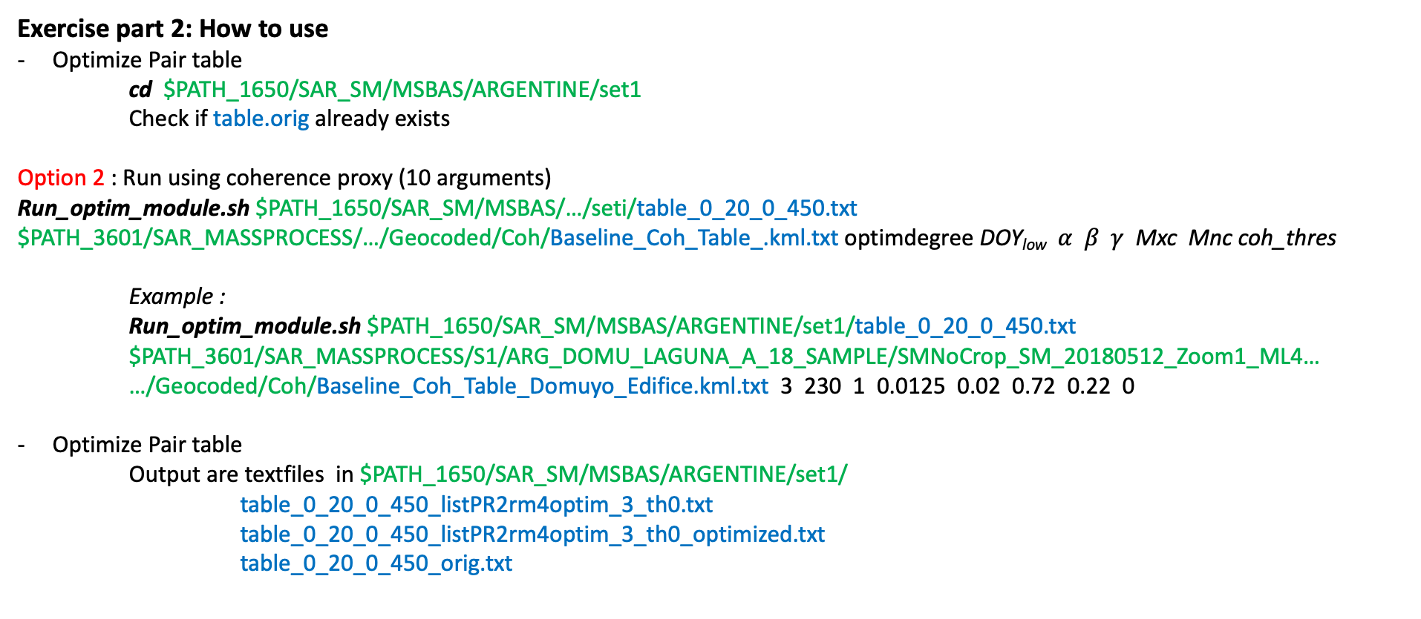
The optimization toolbox practically
Exercise part 2: How to use
Optimize Pair table
cd $PATH_1650/SAR_SM/MSBAS/ARGENTINE/set1
Check if table.orig already exists
Option 2 : Run using coherence proxy (10 arguments)
Run_optim_module.sh $PATH_1650/SAR_SM/MSBAS/…/seti/table_0_20_0_450.txt
$PATH_3601/SAR_MASSPROCESS/…/Geocoded/Coh/Baseline_Coh_Table_.kml.txt optimdegree DOY_{low} $α β γ$ Mxc Mnc coh_thres
Example :
Run_optim_module.sh $PATH_1650/SAR_SM/MSBAS/ARGENTINE/set1/table_0_20_0_450.txt
$PATH_3601/SAR_MASSPROCESS/S1/ARG_DOMU_LAGUNA_A_18_SAMPLE/SMNoCrop_SM_20180512_Zoom1_ML4…
…/Geocoded/Coh/Baseline_Coh_Table_Domuyo_Edifice.kml.txt 3 230 1 0.0125 0.02 0.72 0.22 0
Optimize Pair table
Output are textfiles in $PATH_1650/SAR_SM/MSBAS/ARGENTINE/set1/
table_0_20_0_450_listPR2rm4optim_3_th0.txt
table_0_20_0_450_listPR2rm4optim_3_th0_optimized.txt
table_0_20_0_450_orig.txt

Slide 37
The optimization toolbox practically
Exercise part 2: How to use
Prepare MSBAS
cd $PATH_3602/MSBAS/_Argentina_S1_20m_450days
If not already done : build_header_msbas_criteria.sh
Save a copy of DefoInterpolx2Detrend1.txt
cp DefoInterpolx2Detrend1.txt DefoInterpolx2Detrend1_orig.txt
For each set of interest (here only set 1) :
Remove_Pairs_From_BaselinePlotOptimisation.sh DefoInterpolx2Detrend1 $PATH_1650/SAR_SM/MSBAS/ARGENTINE/set1/table_0_20_0_450_listPR2rm4optim_3_th0.txt
Output is a text file DefoInterpolx2Detrend1_Optimized_TABLE.txt_RUNTIME.txt
To run msbas without optimization :
cp DefoInterpolx2Detrend1_orig.txt DefoInterpolx2Detrend1.txt
To run msbas with optimized table :
cp DefoInterpolx2Detrend1_Optimized_table_0_20_0_450_listPR2rm4optim_3_th0.txt_05_16_2023_13h43m.txt DefoInterpolx2Detrend1.txt
Update header.txt : here only one set, comment line for set 2
Launch : MSBAS.sh _set1_afteroptim
cd zz_LOS_set1_afteroptim
Visualization : PlotTS.sh 2851 2696 3050 2700 -f -r -t or open maps in QGIS

Slide 38
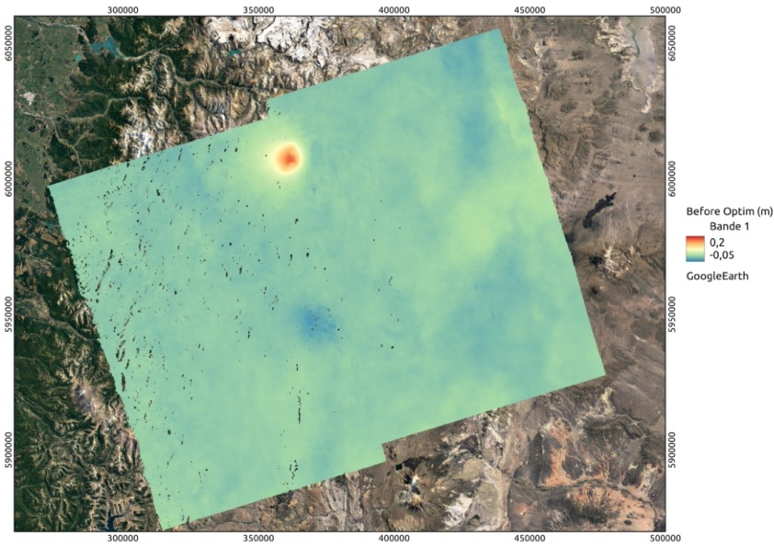
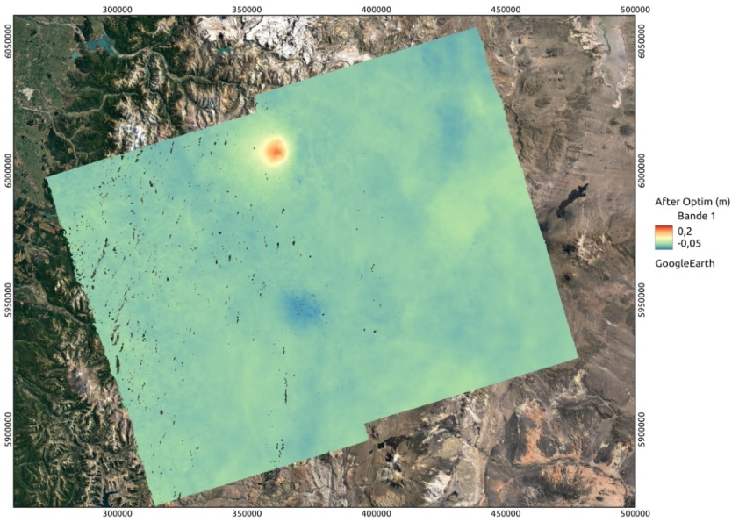
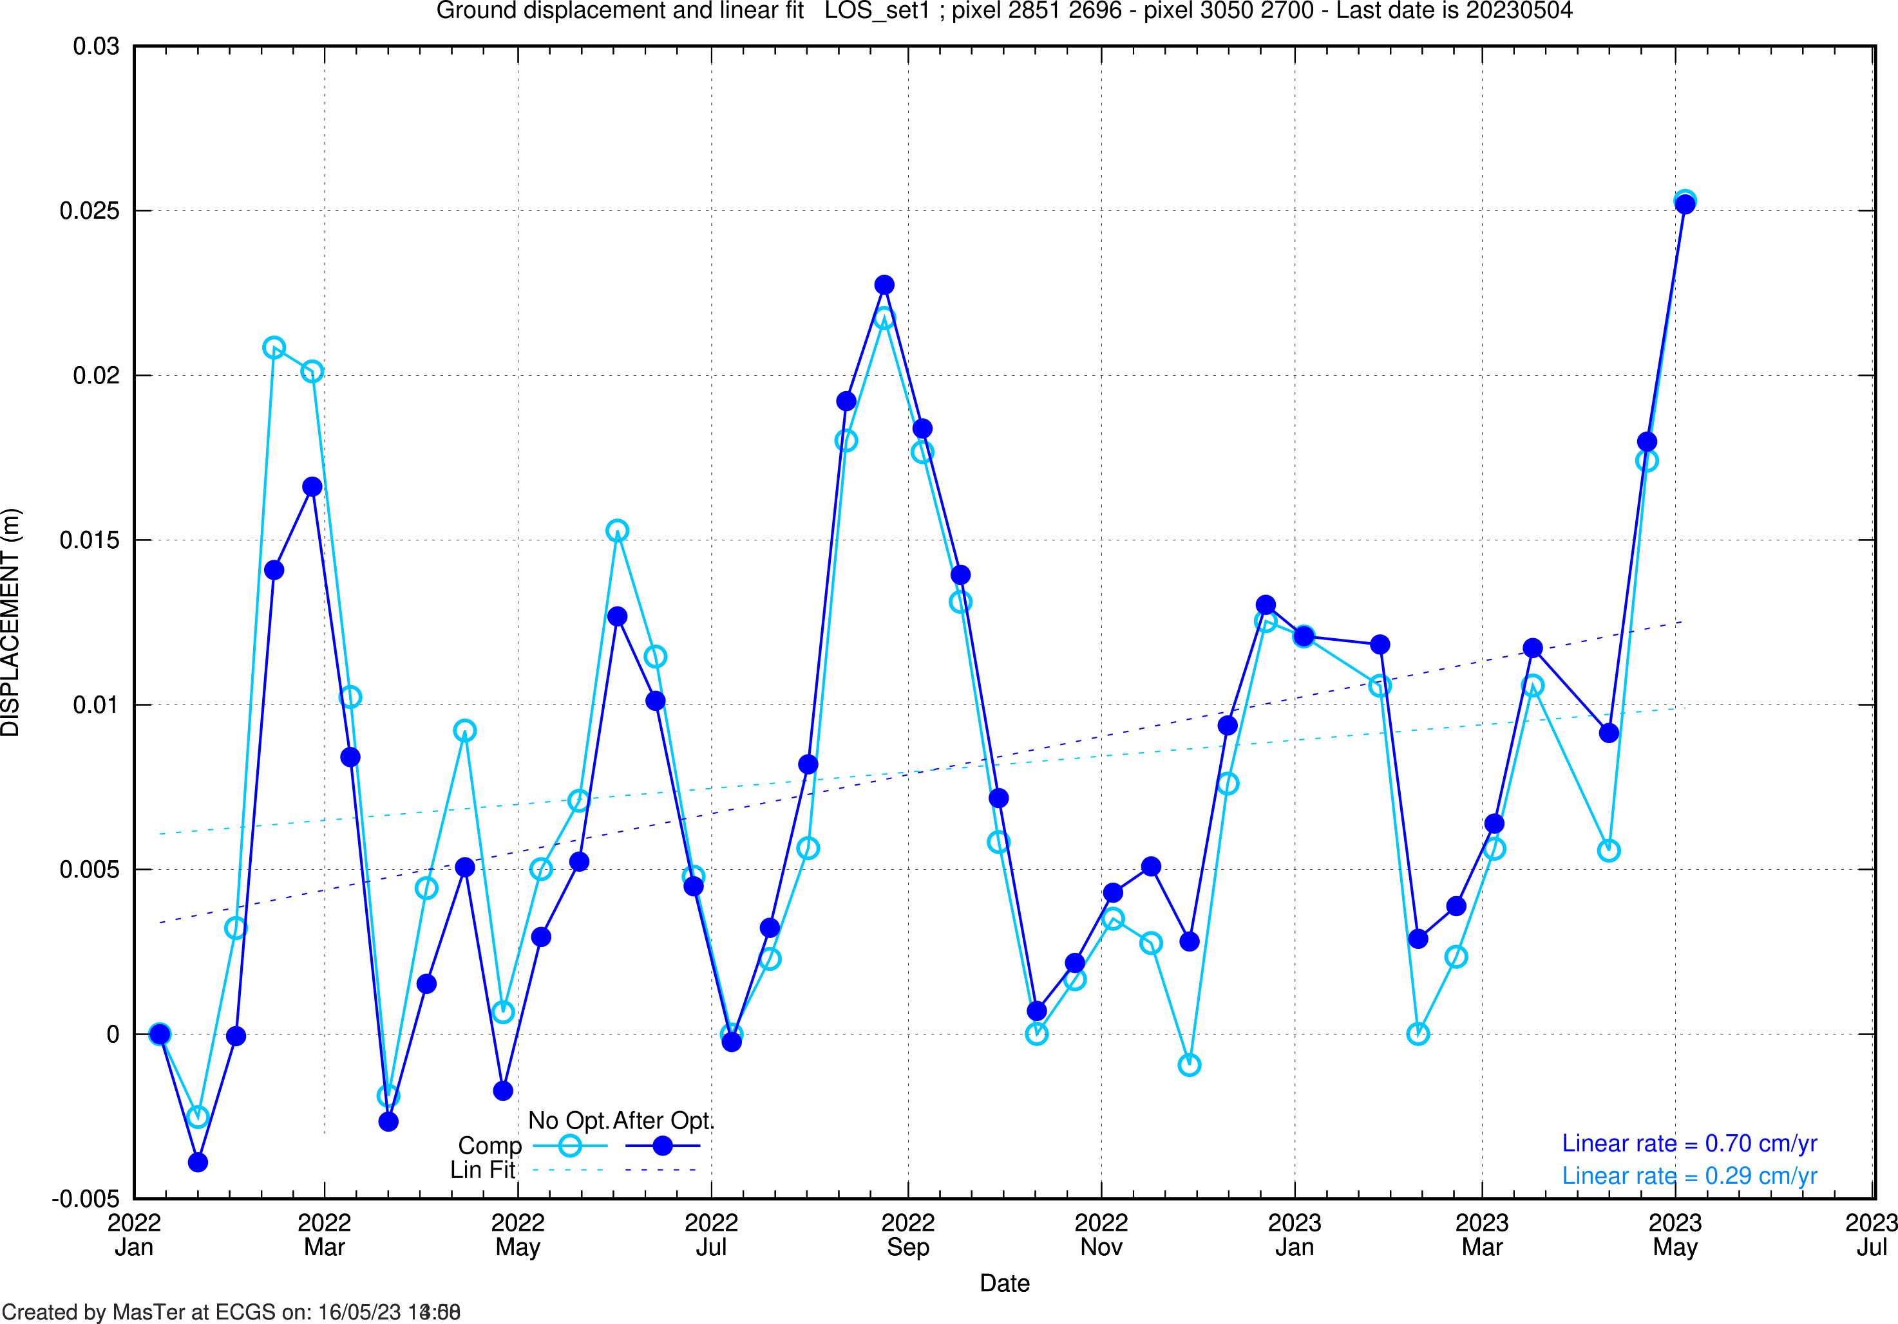
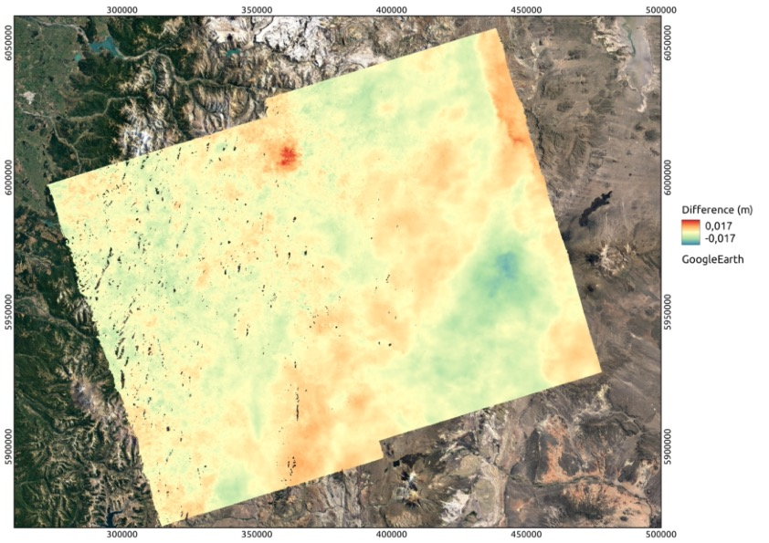
The optimization toolbox practically - Results
No Optim.
After Optim.
Difference

